Slide 1

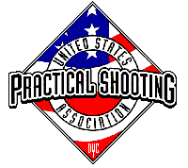
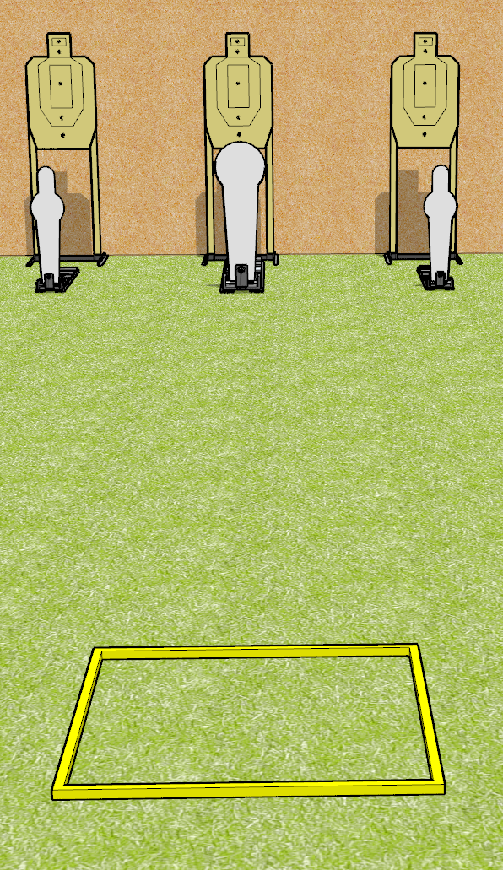
 | Dothan Gun Club – USPSA Match A Simple Speed Shoot Course Designer : Drew Coleman
Round Count 9 rounds 3 USPSA targets 2 mini poppers, 1 colt popper
Equipment List Shooting box

Slide 2
A Simple Speed Shoot
Written Stage Briefing
A Simple Speed Shoot is a 9 round, 45 point, Comstock speed shoot. There are 3 USPSA targets, 2 mini poppers, and 1 colt poppers. The best 2 hits on paper will score, and steel must fall to score. The start signal is audible.
Handgun start position is facing uprange, toes touching rear of box, wrists above shoulders. Handgun is loaded and holstered.
PCC start position is in shooting box, stock on belt. Carbine is loaded with safety on.
On start signal, engage EITHER the mini poppers, OR the Colt popper, perform a mandatory reload, and engage the remaining array. The paper targets may be engaged at any time.

